Slide 1
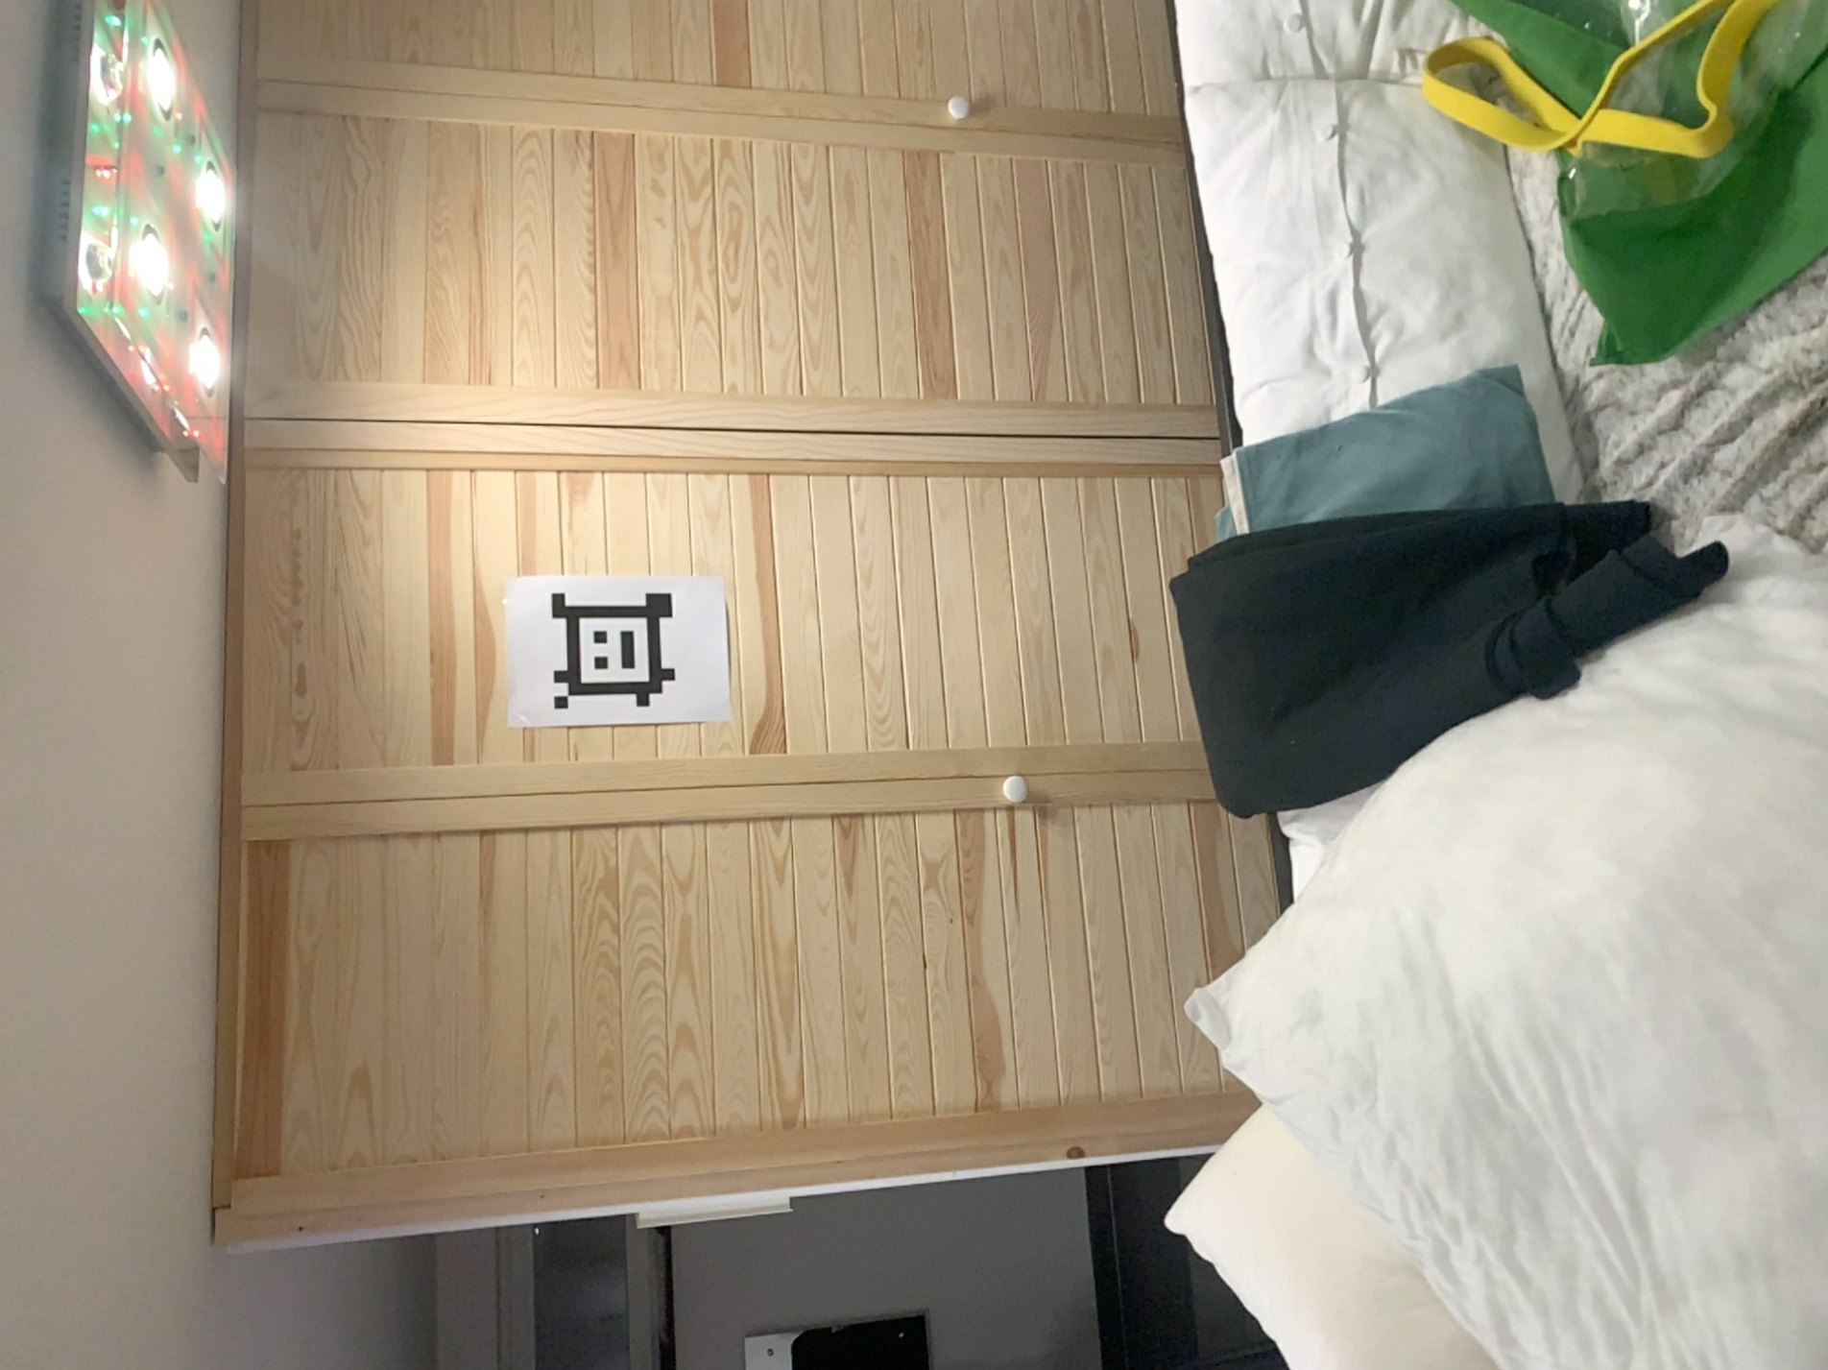
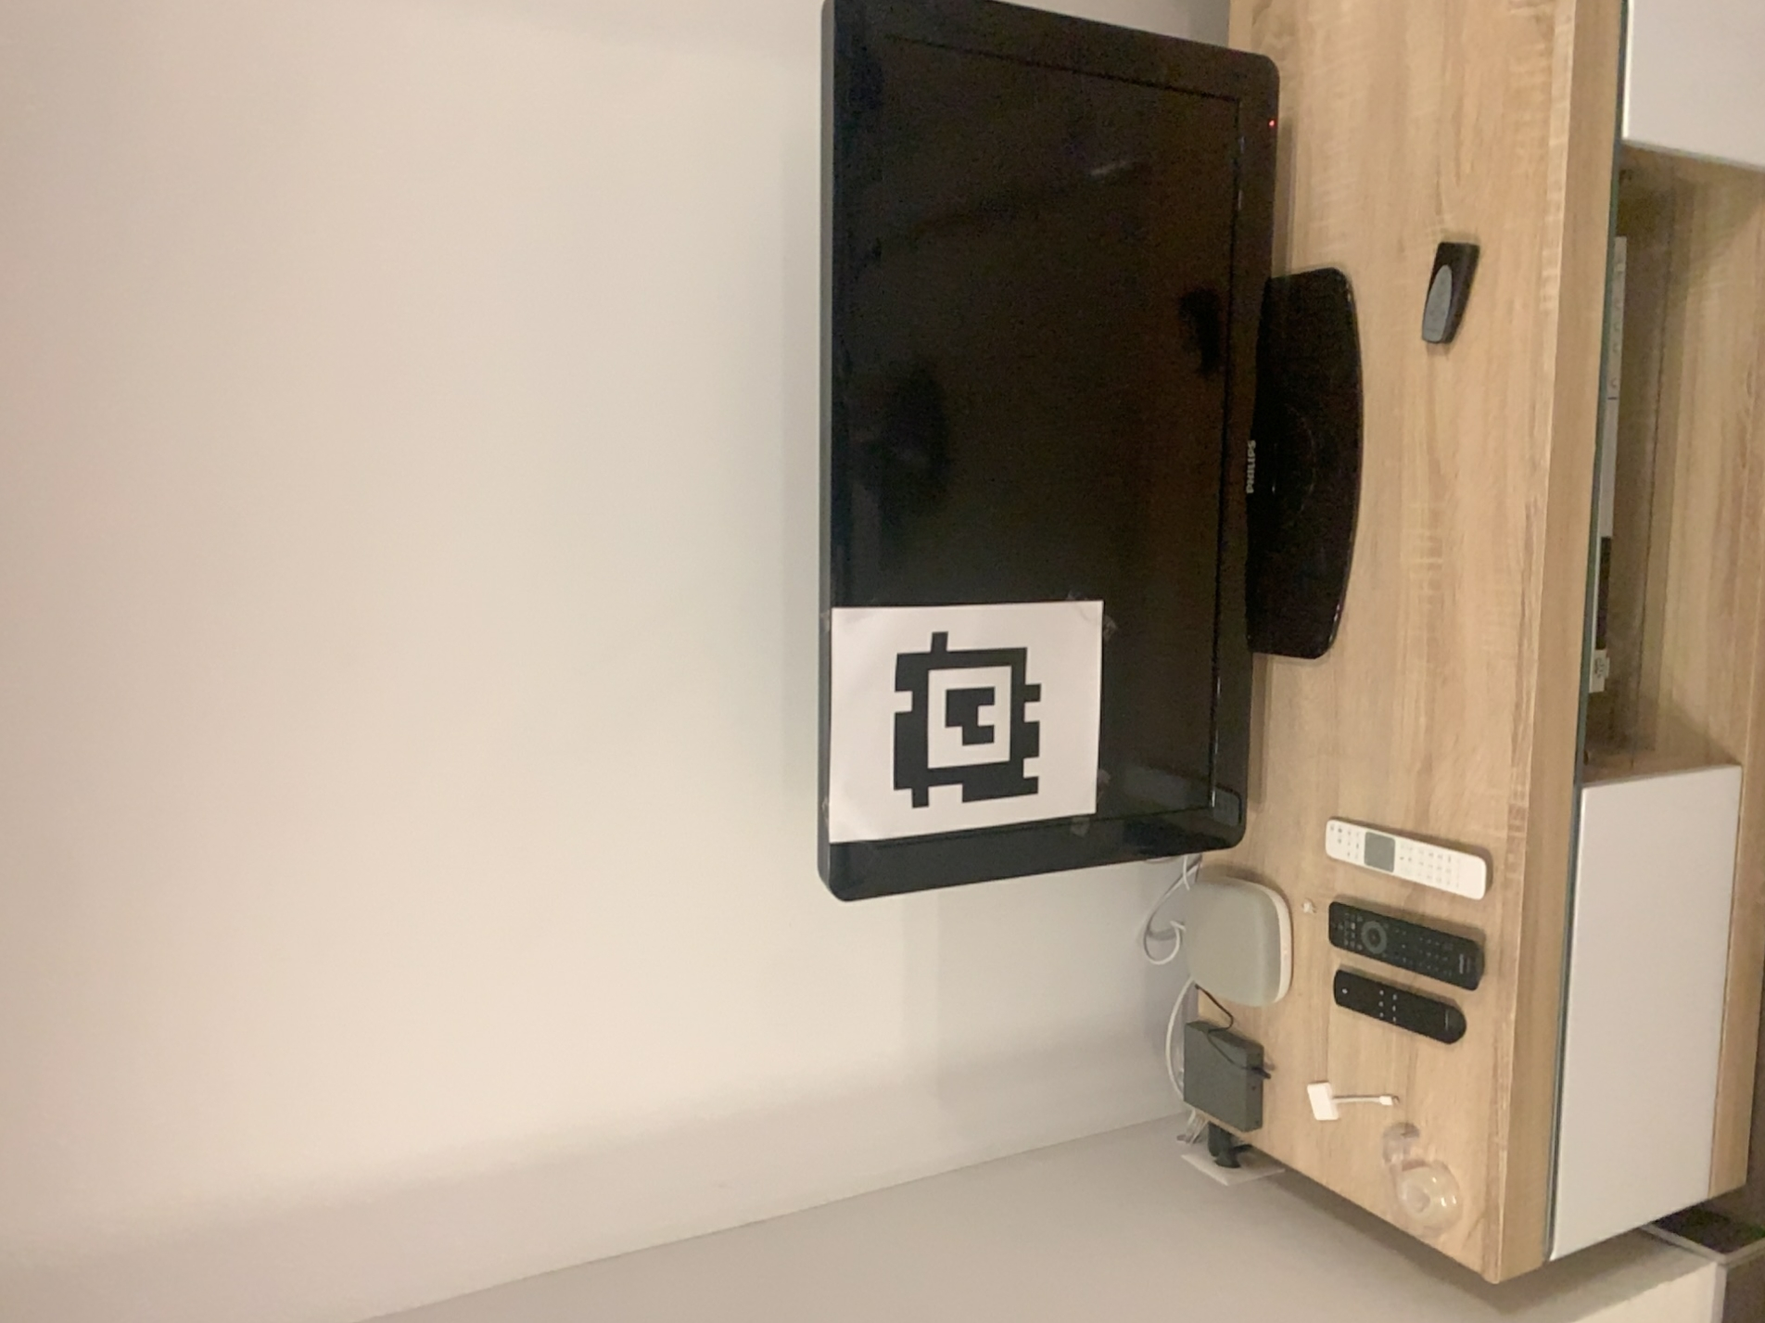
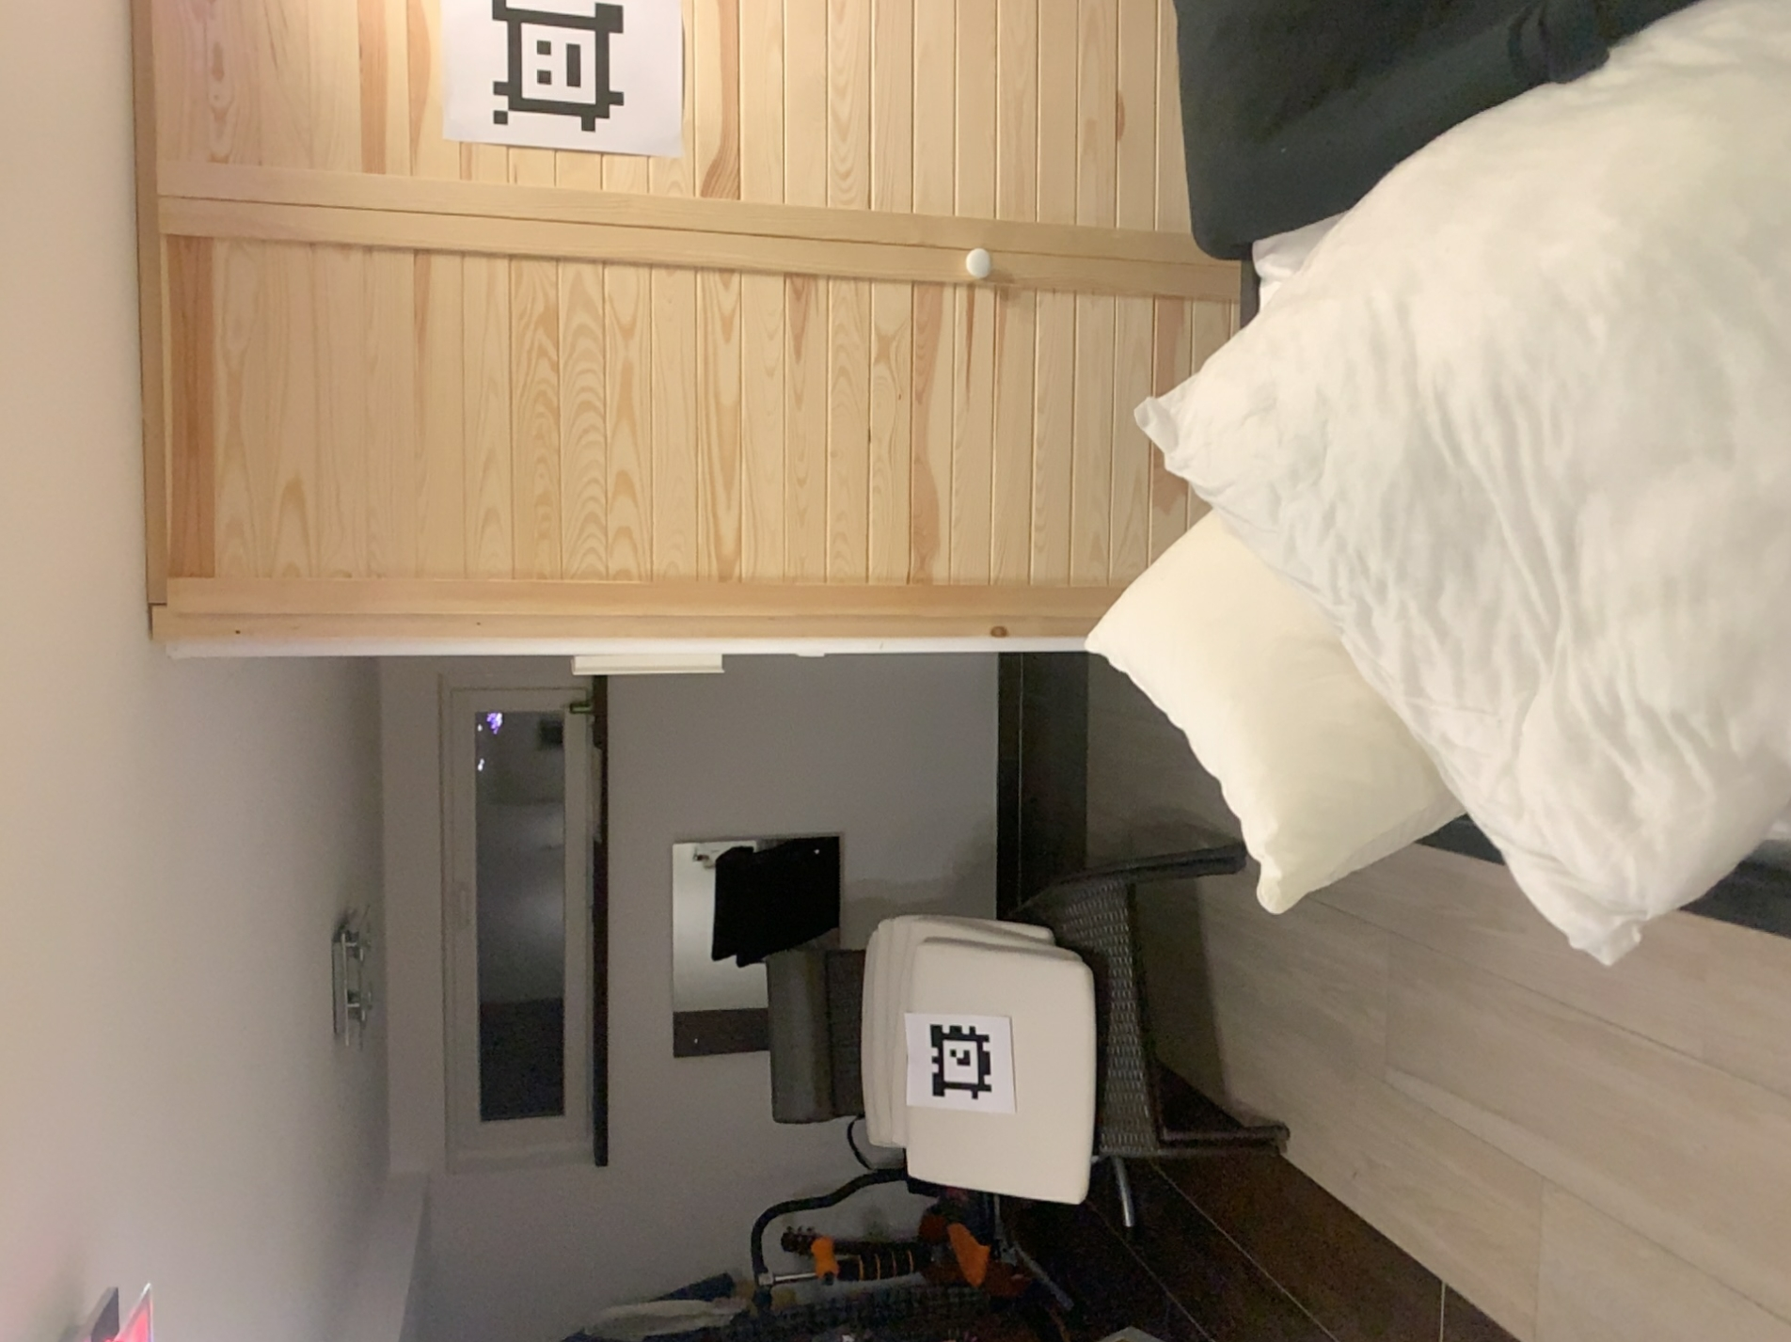
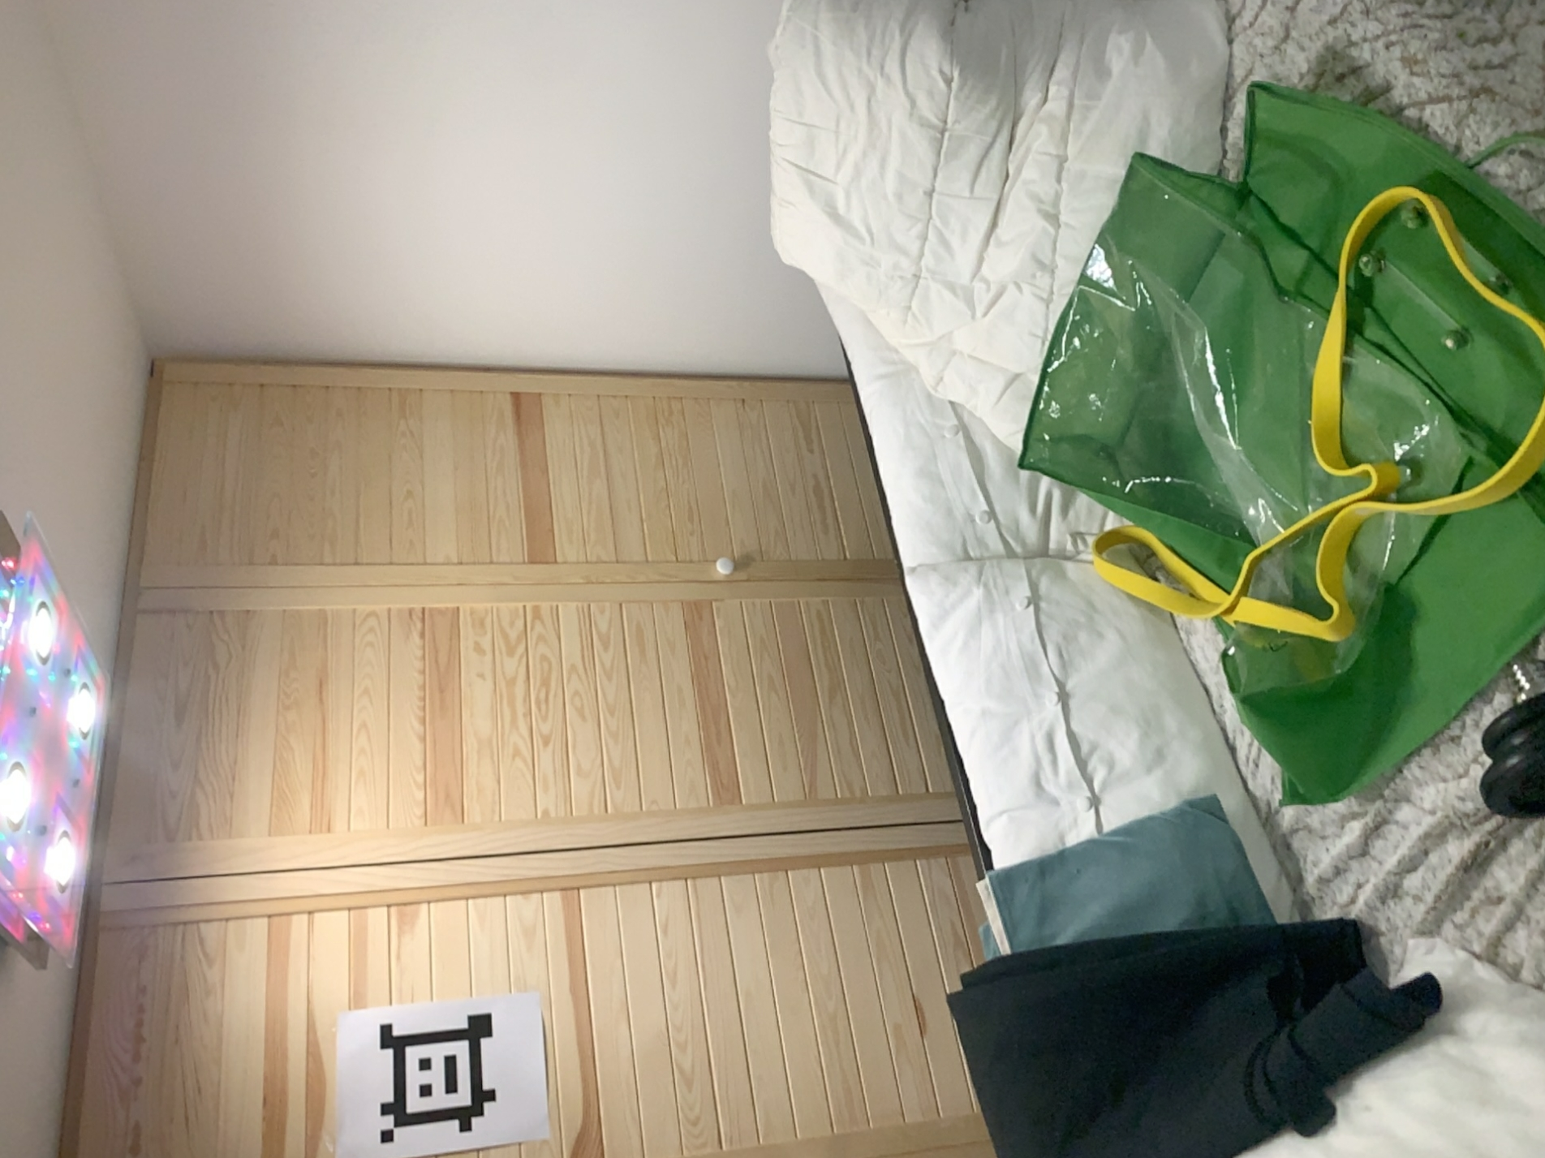
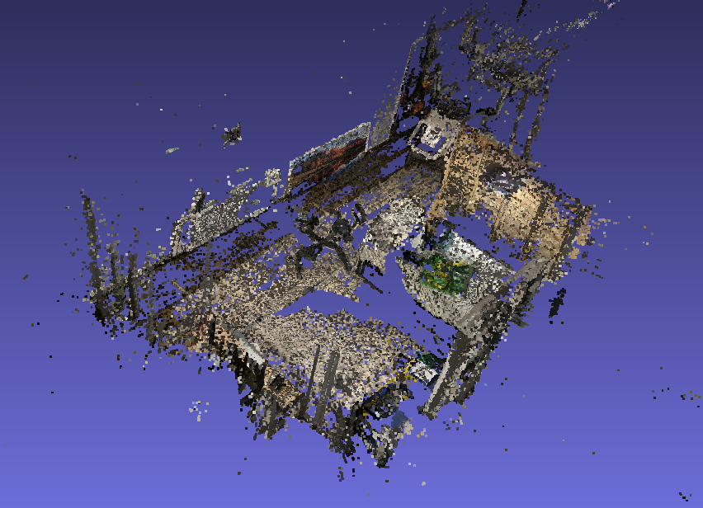
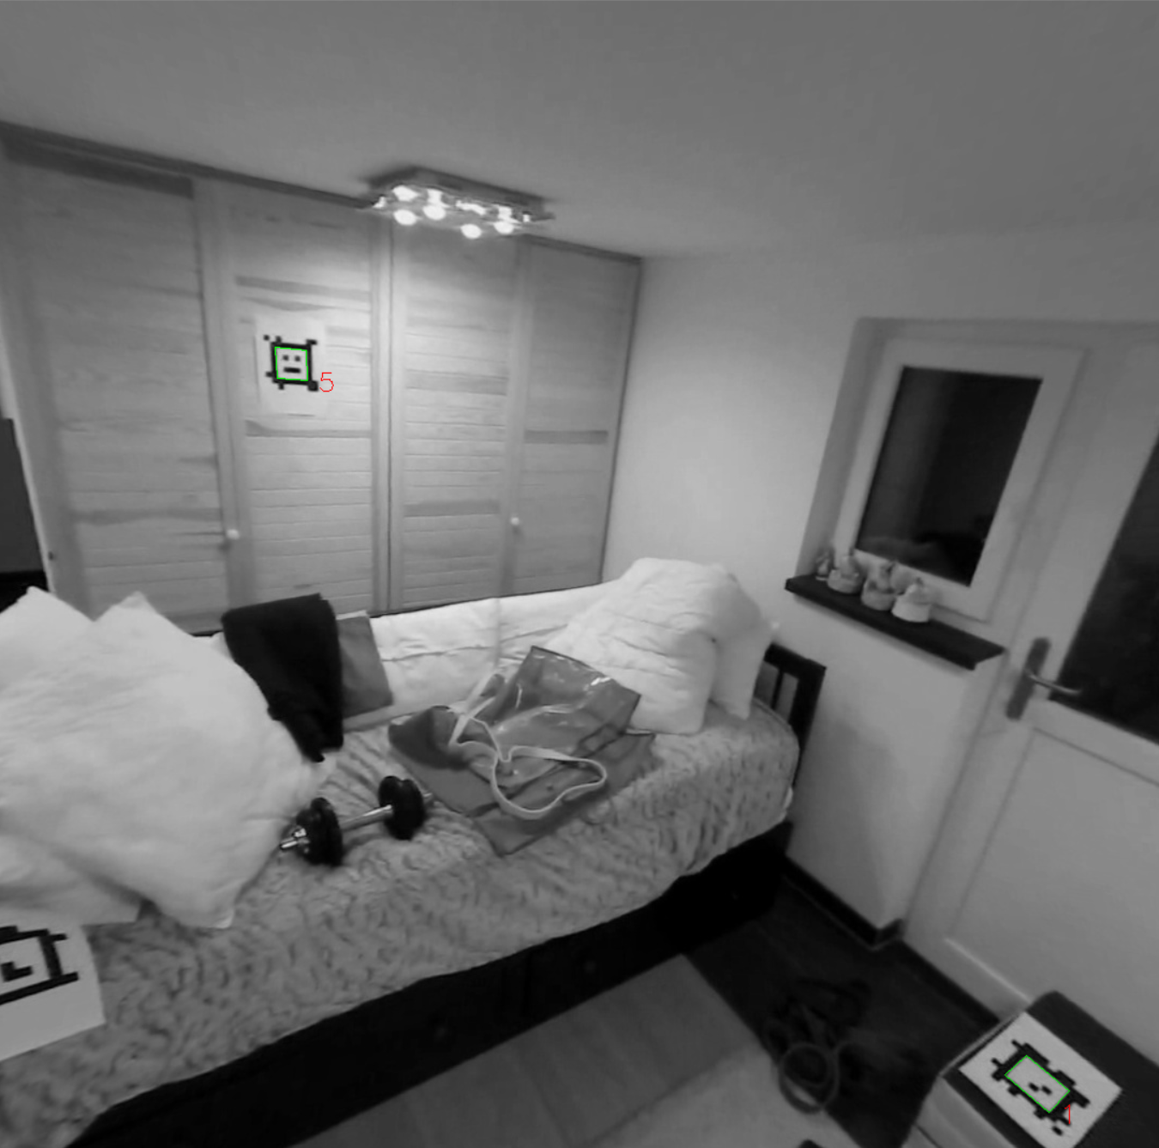
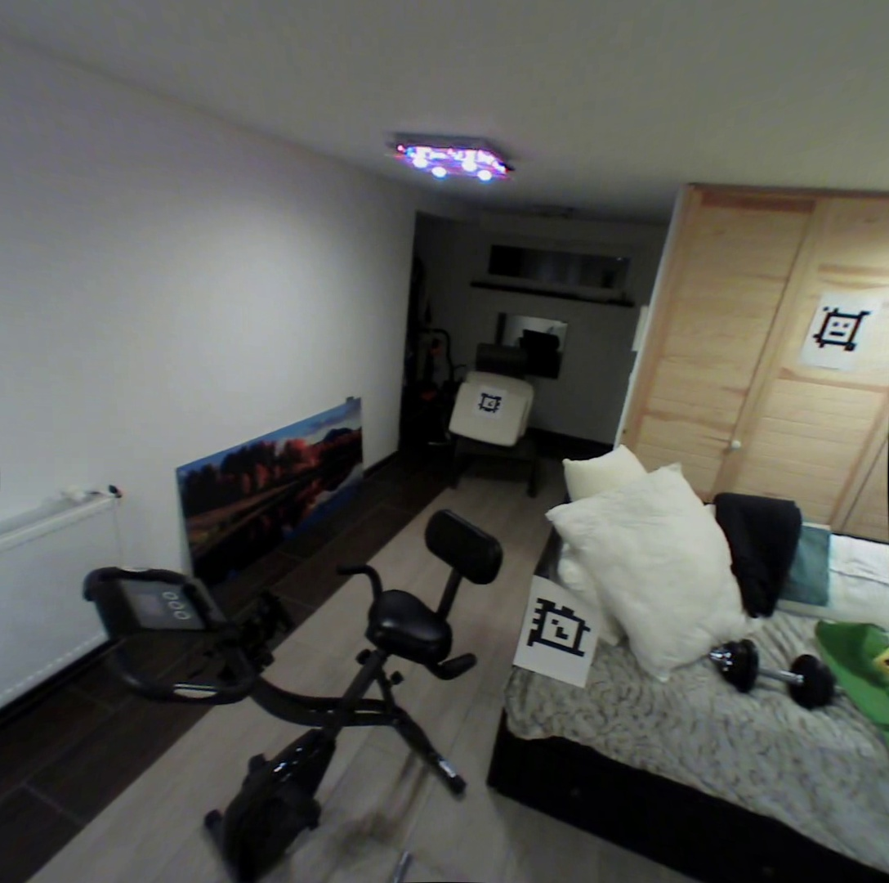
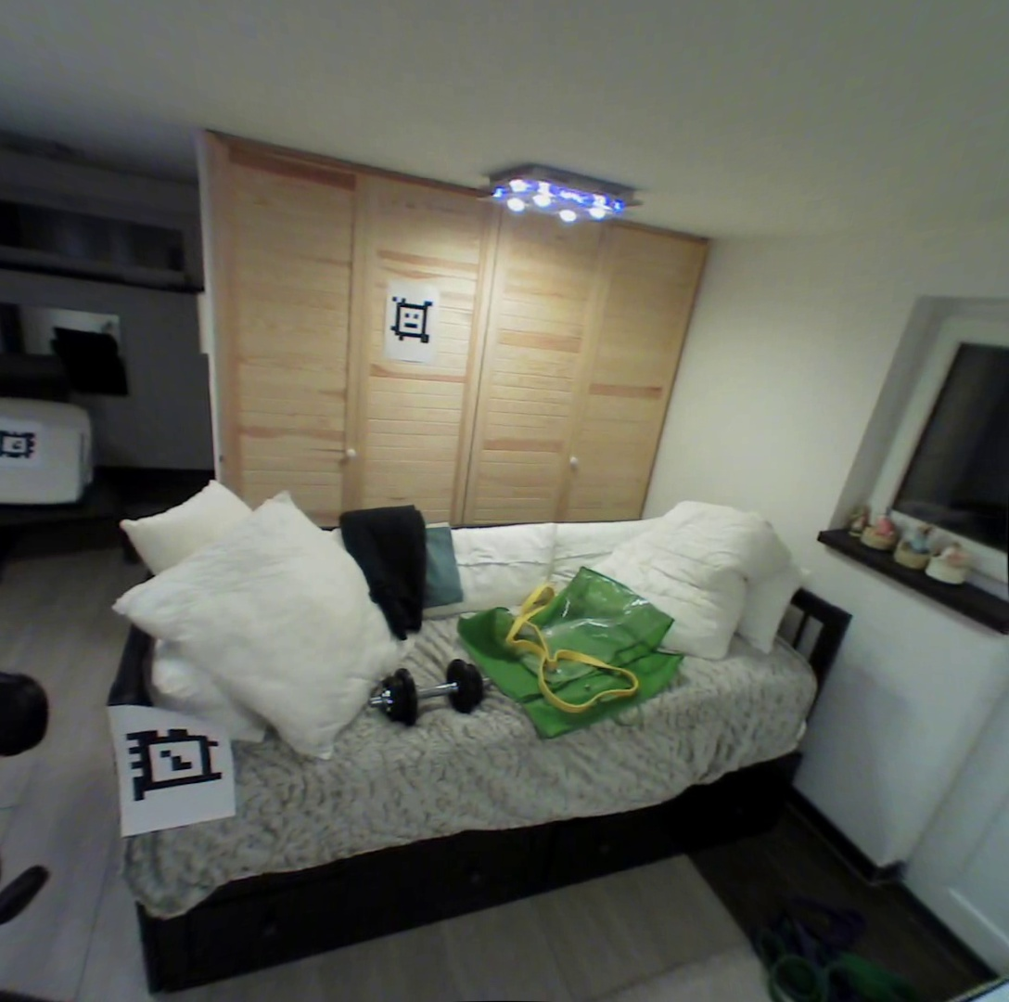
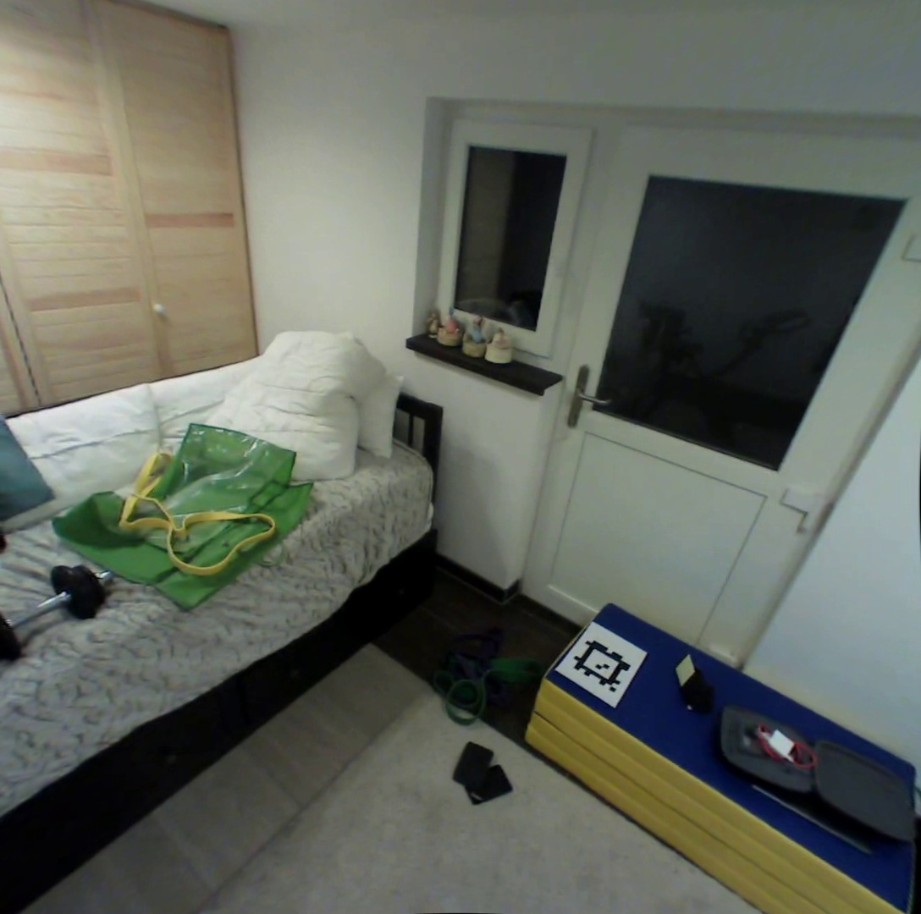
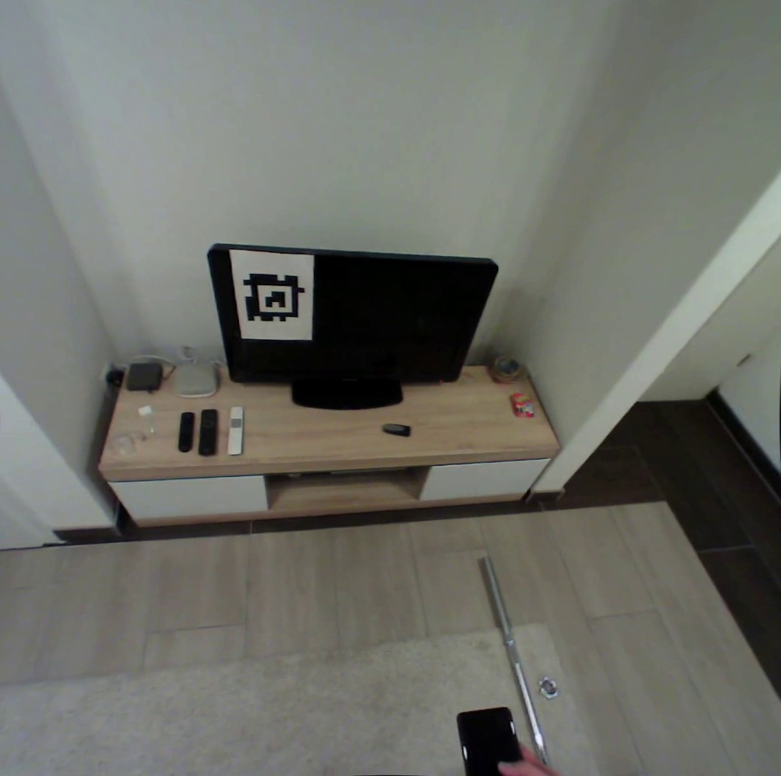
Task: Localization of camera frames from the eye-tracker onto lidar-based room scan
Method 1
Requirement 3: Few camera poses of lidar-device on room scan are needed OR Annotate markers on room scan
Requirement 1: All markers can be detected in frames from lidar-device
From lidar-integrated device
From Pupil-Invisible
Requirement 2: In each frame of eye-tracker, at least one marker can be detected
Register each frame of eye-tracker

Slide 2

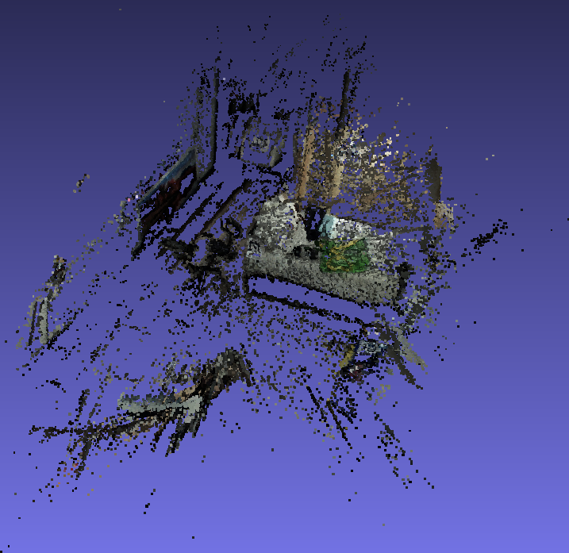
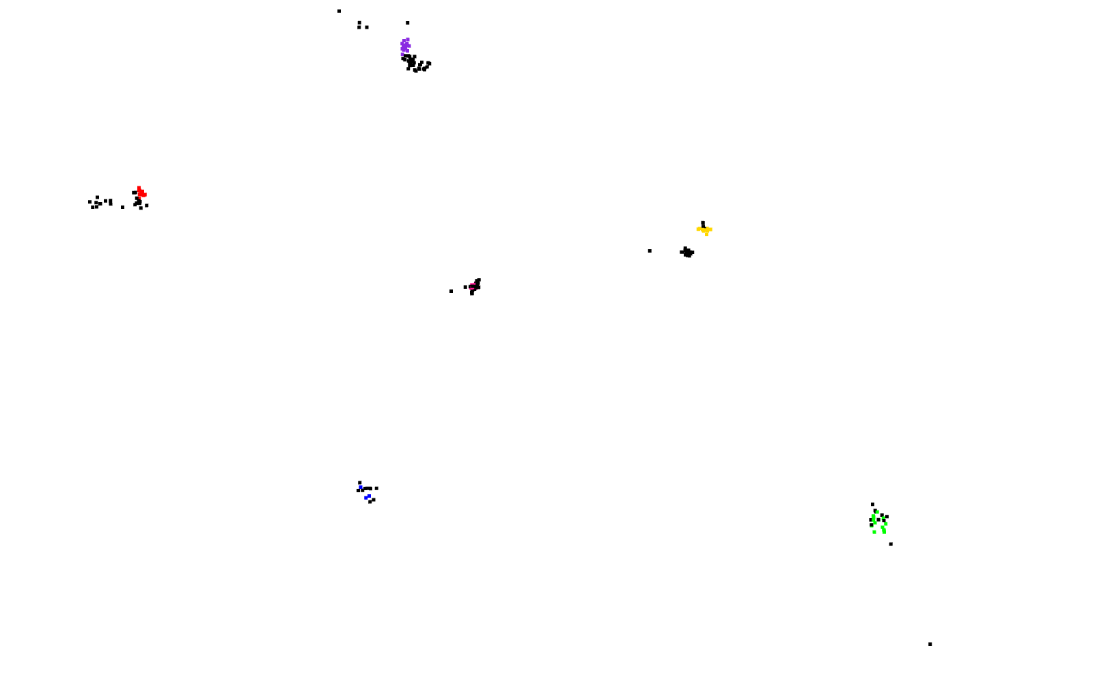

Task: Localization of camera frames from the eye-tracker onto lidar-based room scan
Method 2
* The markers are still under camera coordinate
Requirement 1: All markers can be detected in frames from lidar-device
From lidar-integrated device
Highlight the markers in the point cloud
ICP-Alignment
[$R|sT]_init$
From Pupil-Invisible
Colmap Reconstruction

Slide 3
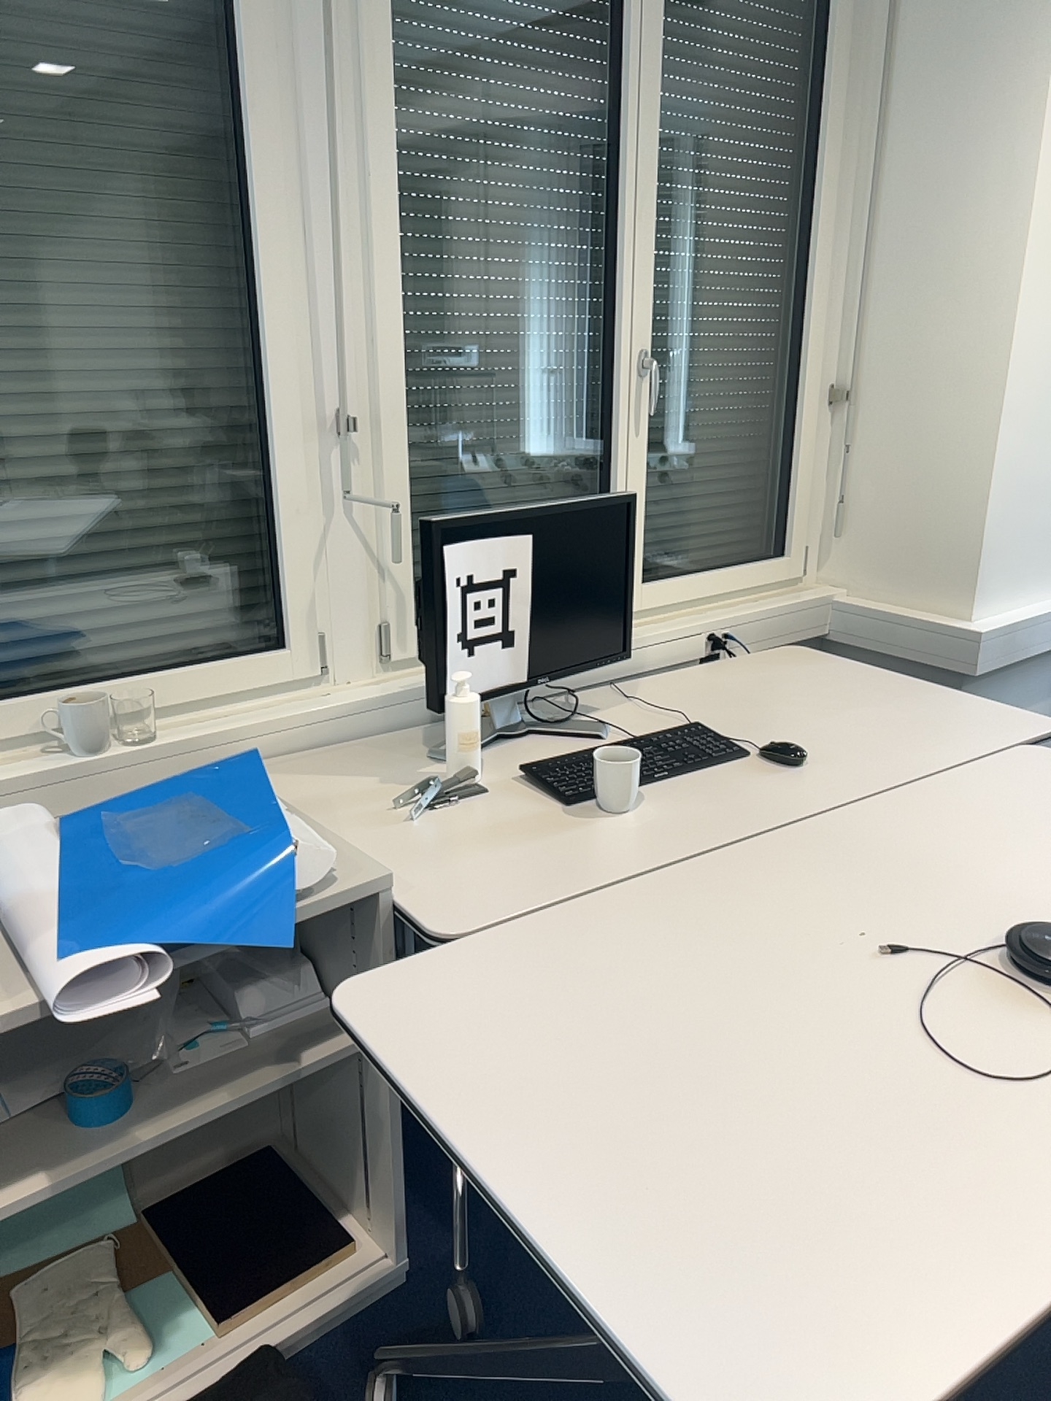
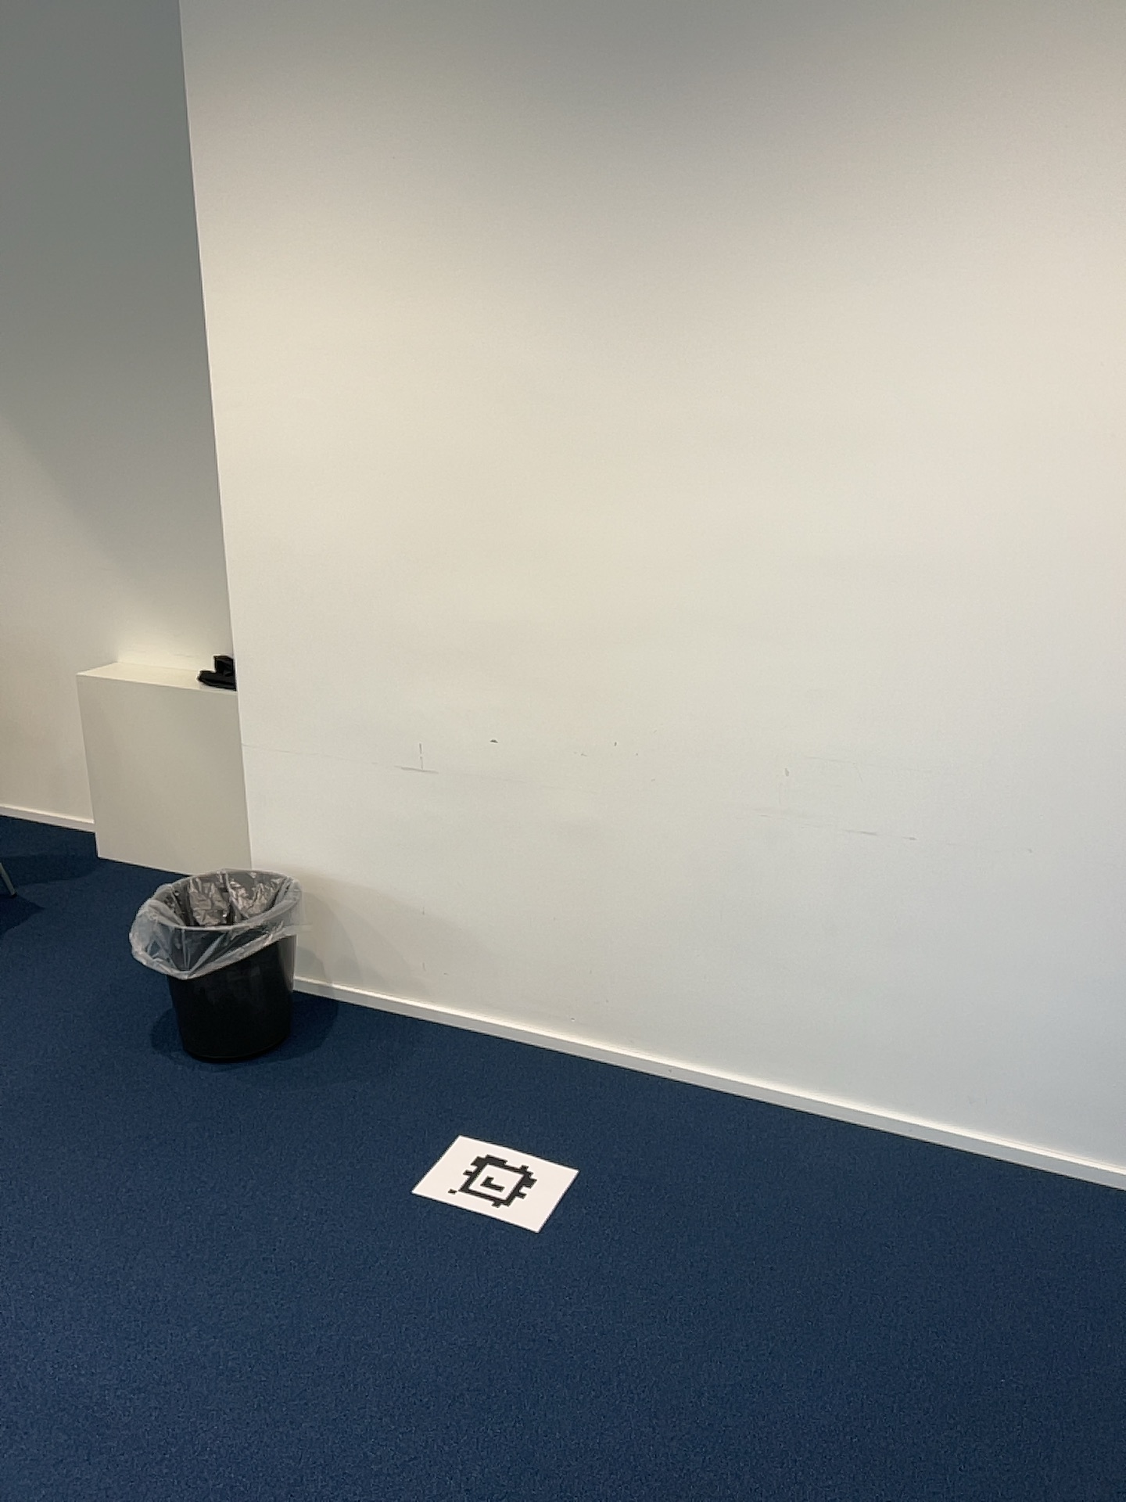
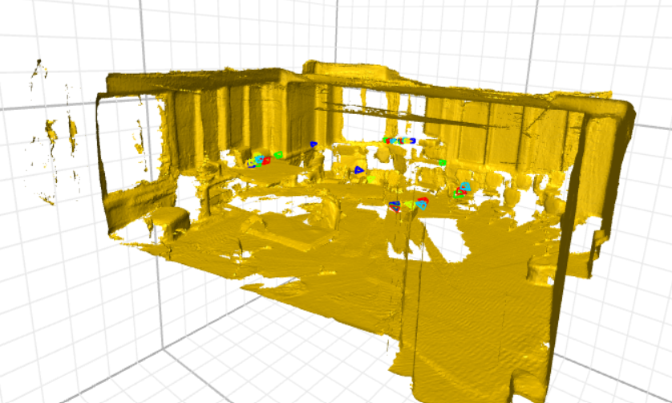
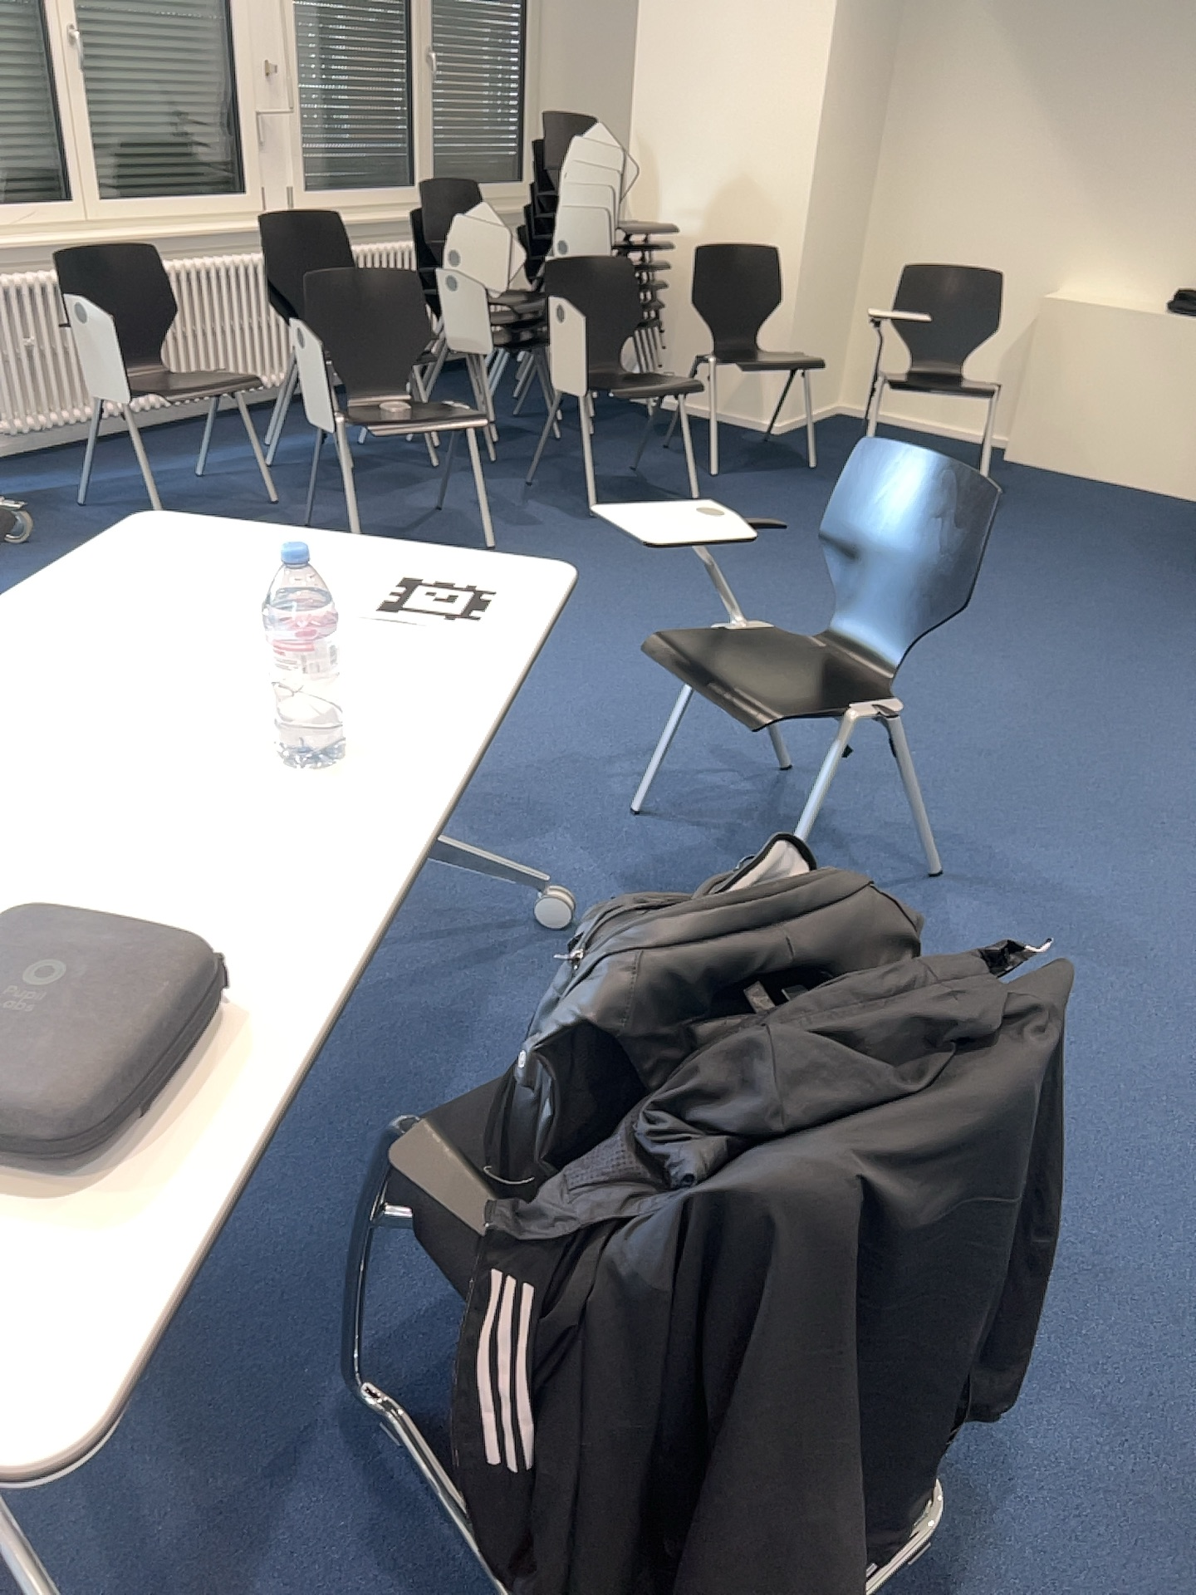
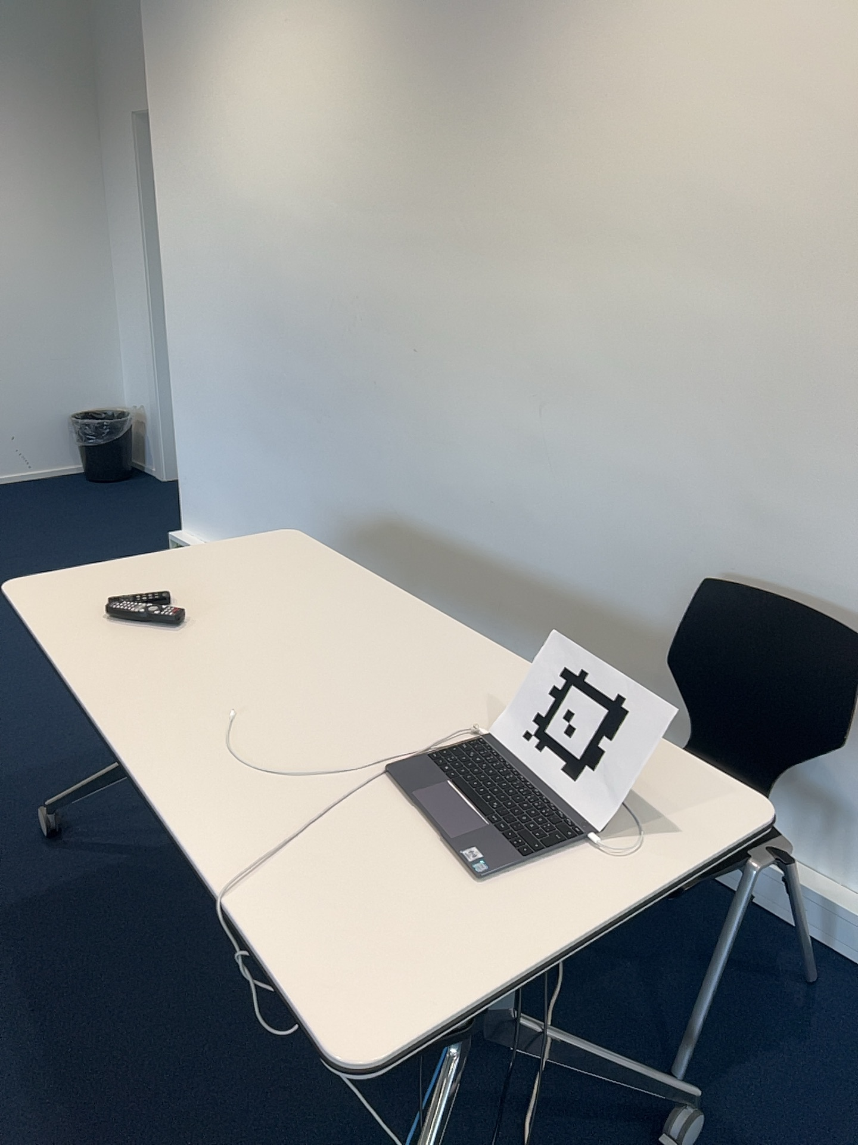
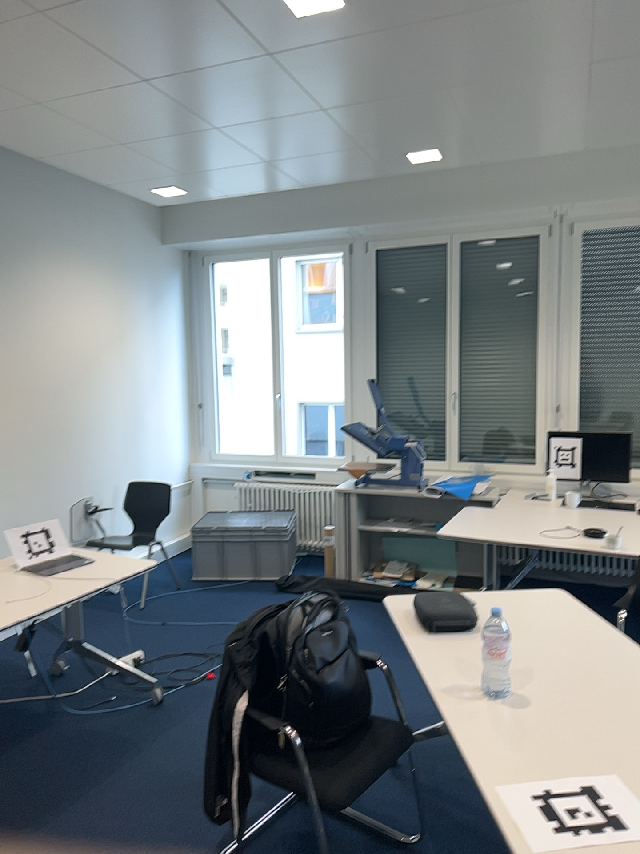
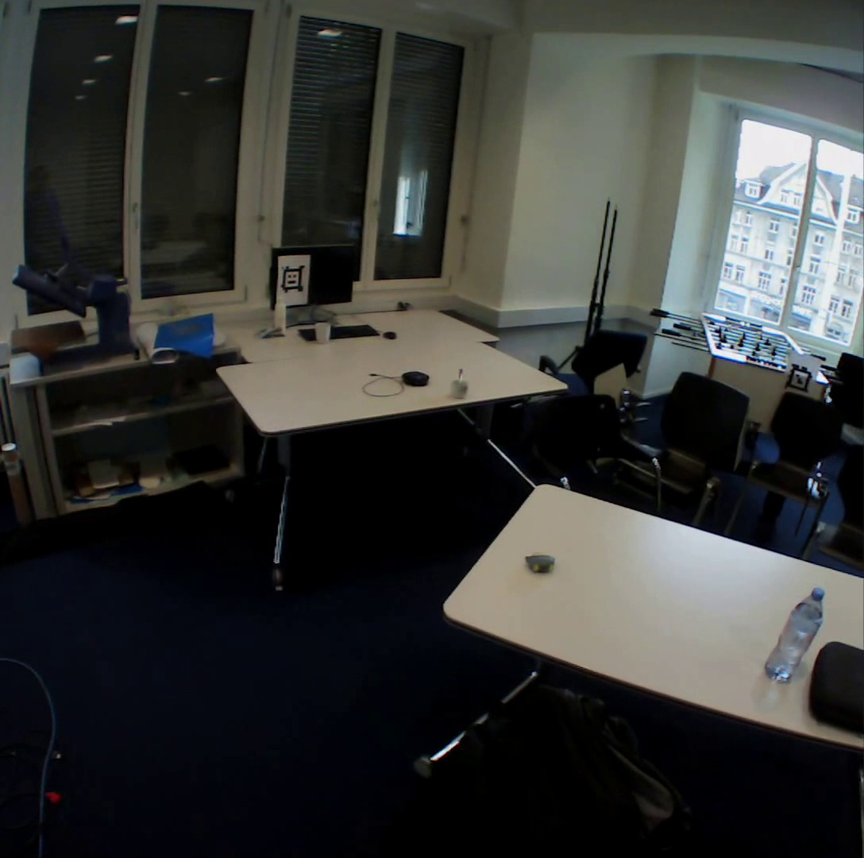
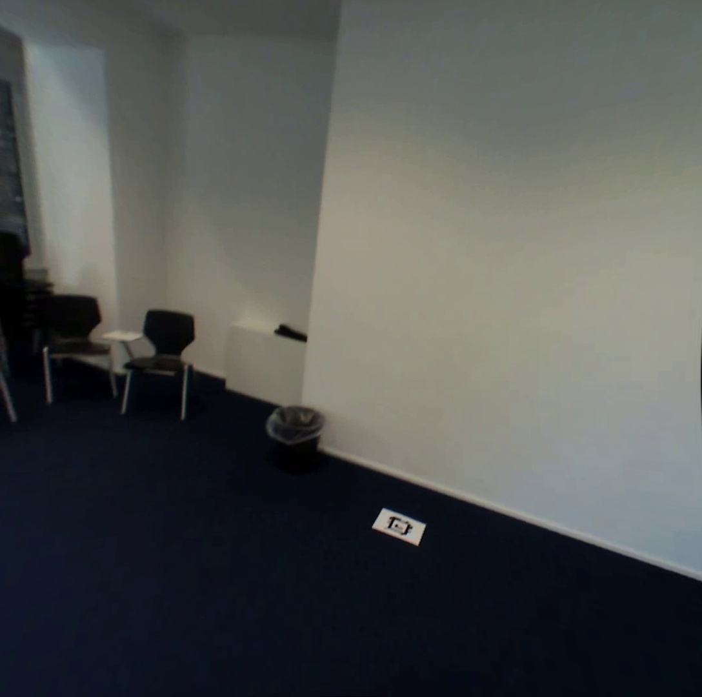
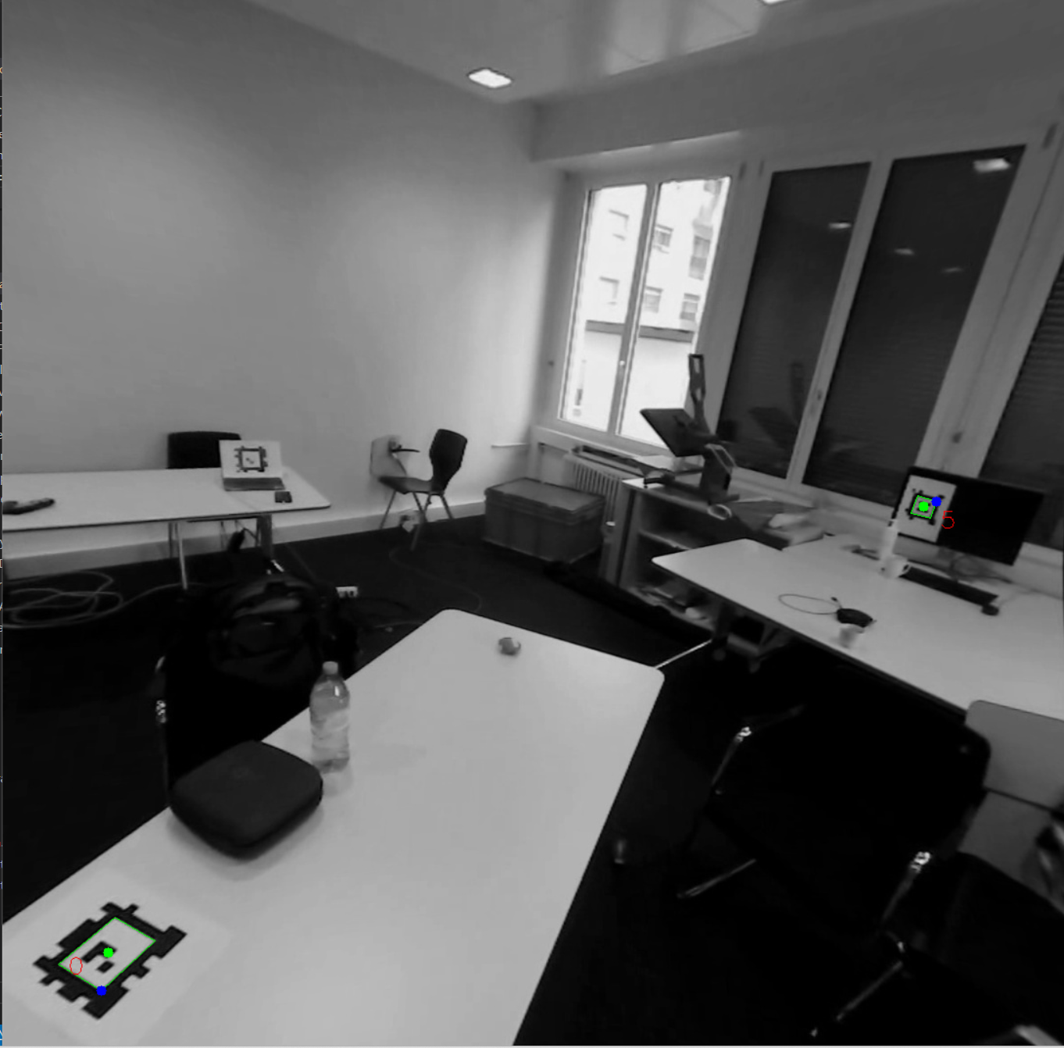
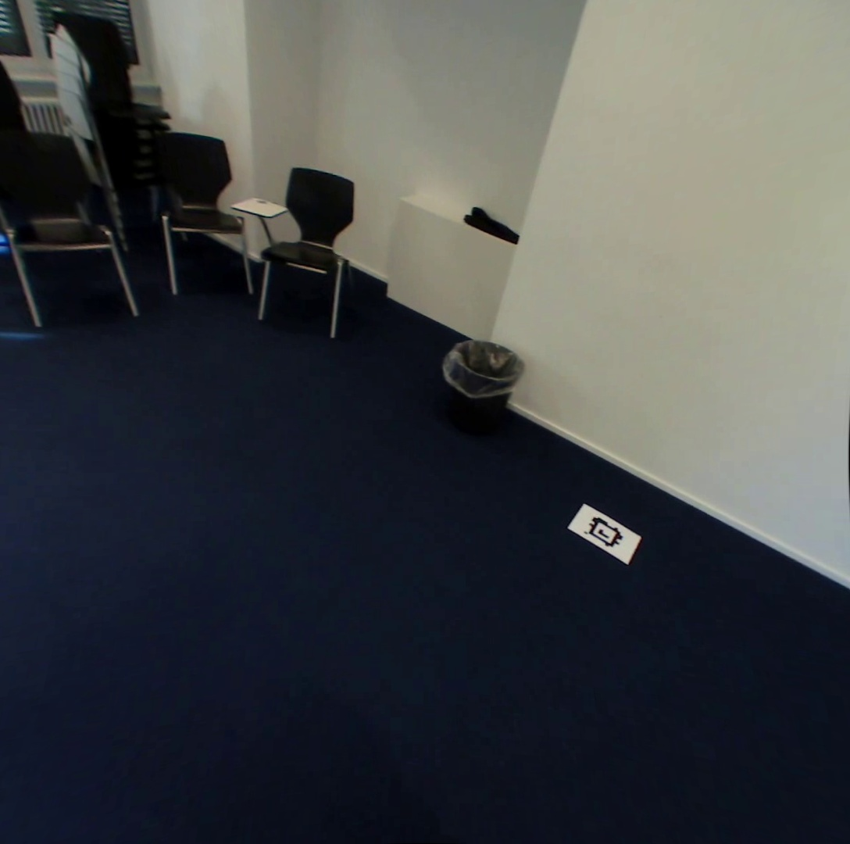
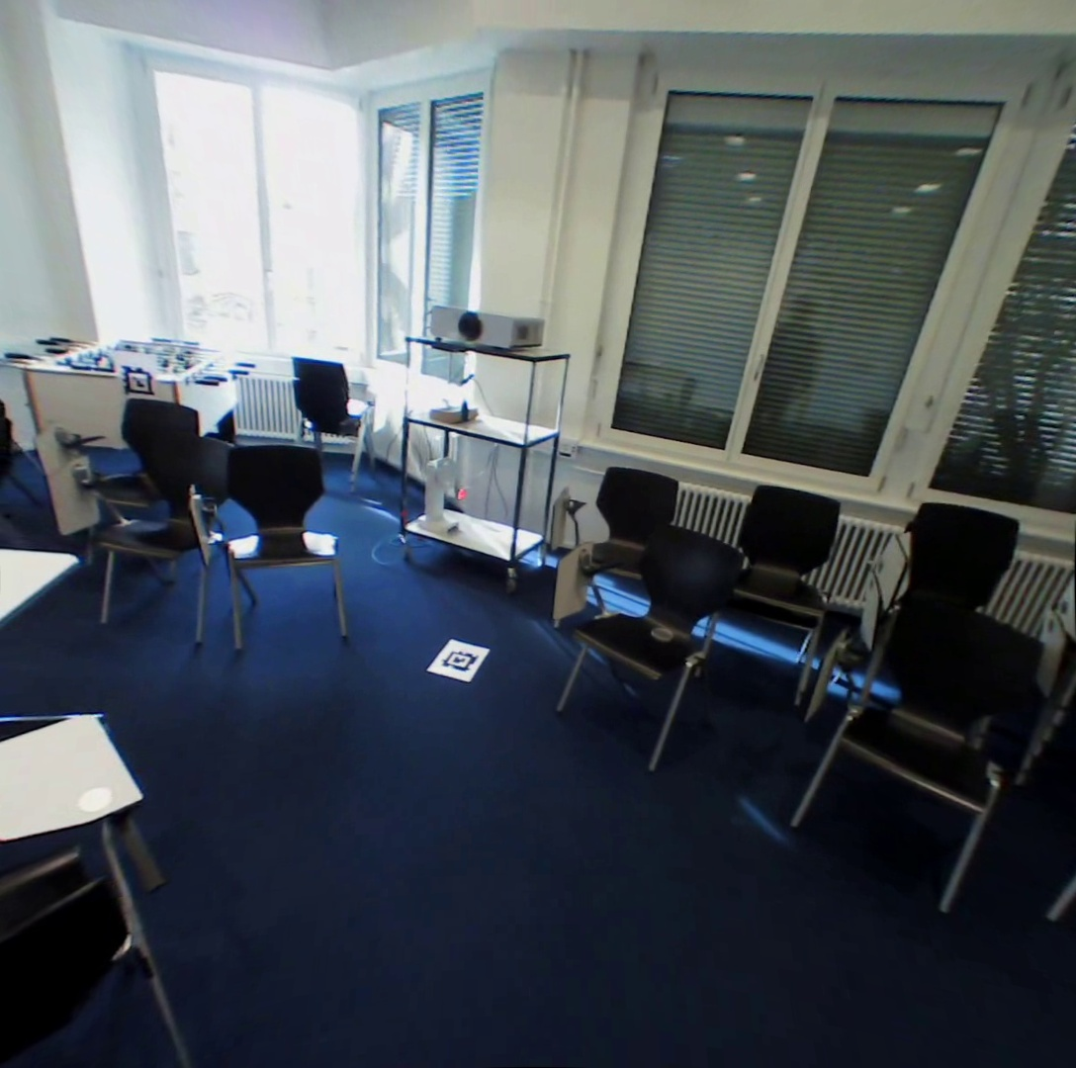
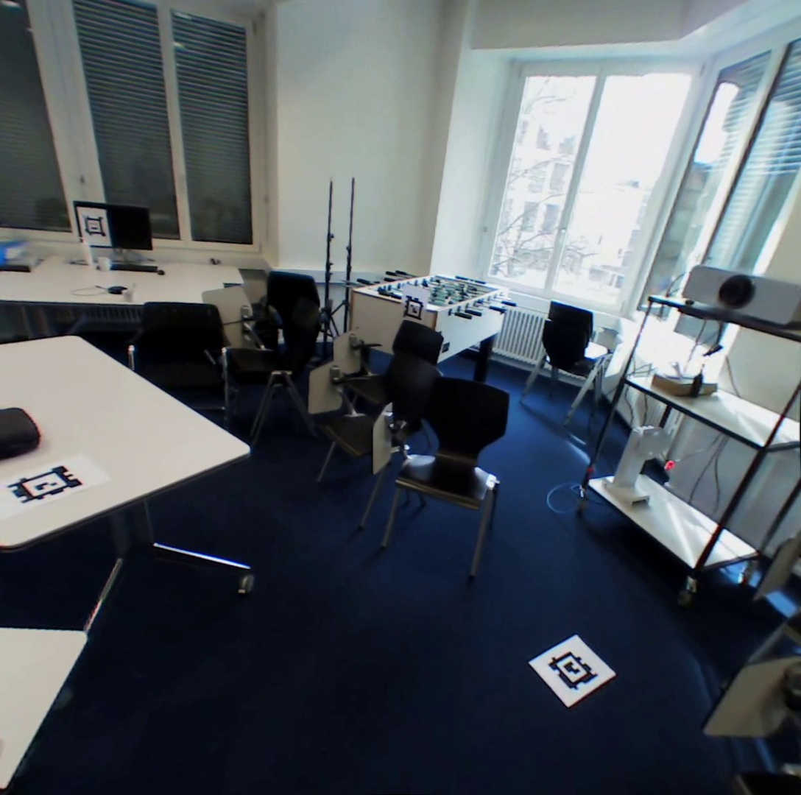
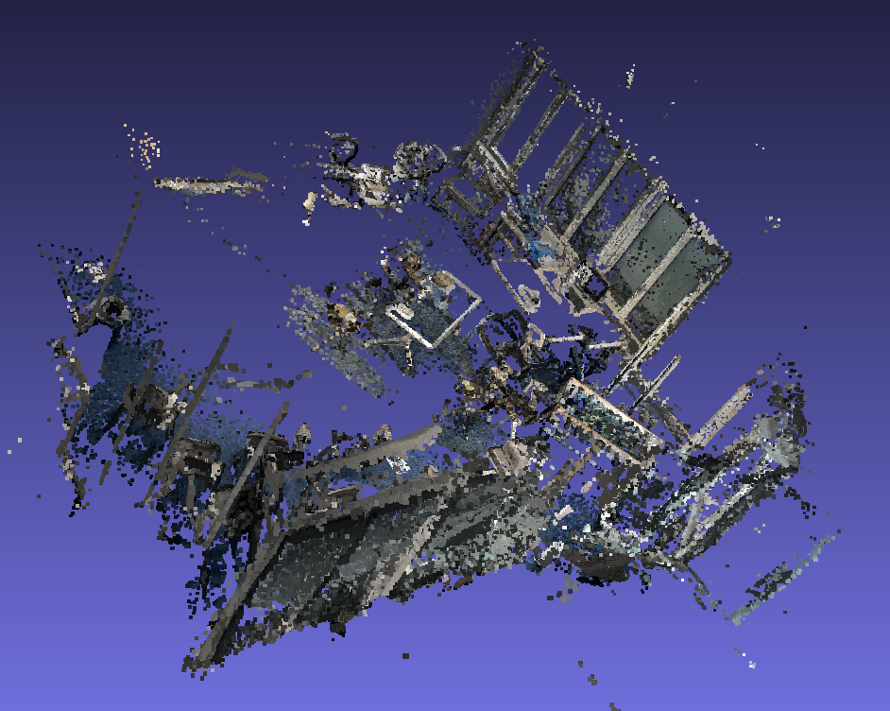
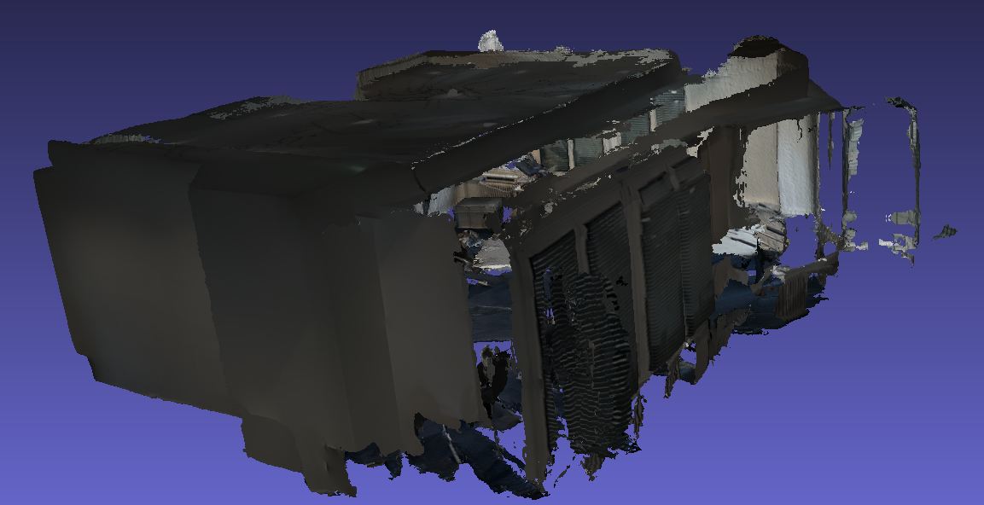

a)
IPhone
b)
c)
Eye-Tracker
[$R|sT]$
f)
e)
d)

Slide 4
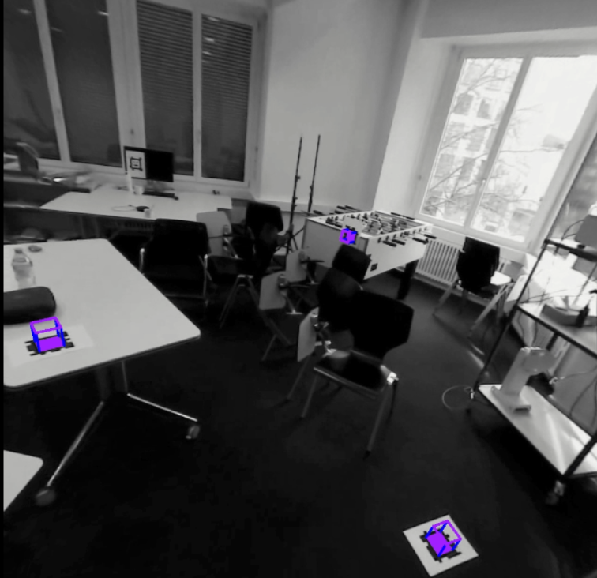
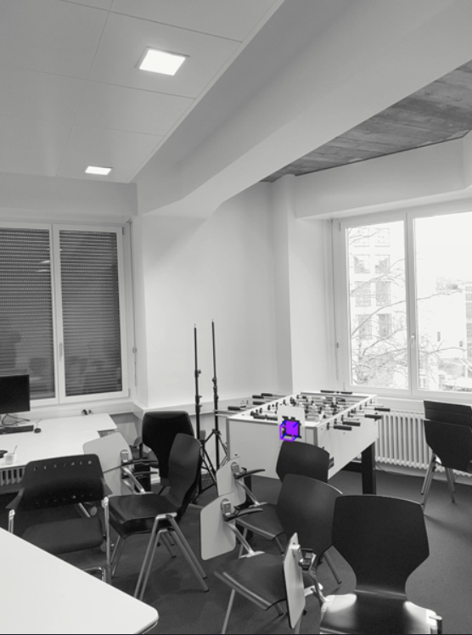

Slide 5
Method 1 vs Method 2
Method 1 is deterministic
Method 2 has the accumulated error (colmap, keypoints alignment, icp)
Method 1 is able to work under some conditions (at least the camera pose of room scanning is required)
Method 2 has less constraints on dataset
How to apply method 1 when the pre-scanned camera pose is unknown?
Annotate the markers in scanned point cloud manually and compute the transformation matrix
Detect the marker directly in scanned point cloud

